Slide 1
Predicting Stock Prices using Daily News Headlines
Spandan Gupta

Slide 2
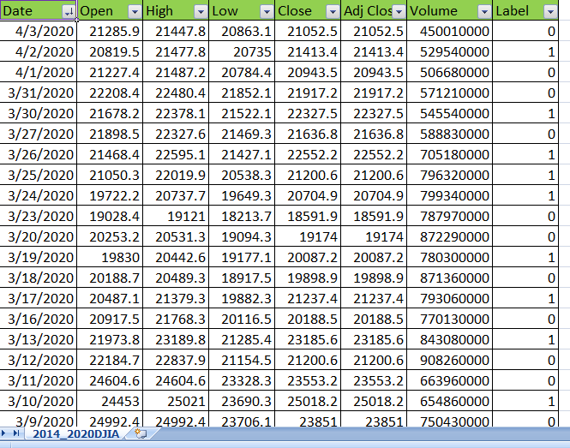
DJIA Historical Stock Data

Slide 3
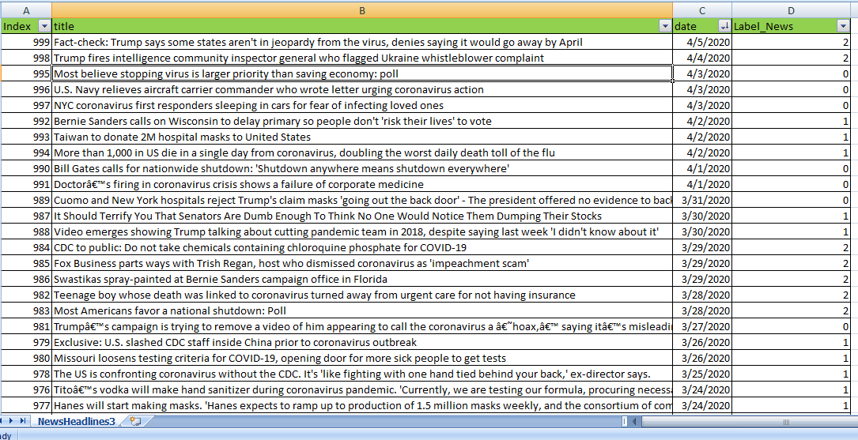
Top News Headlines on Reddit

Slide 4
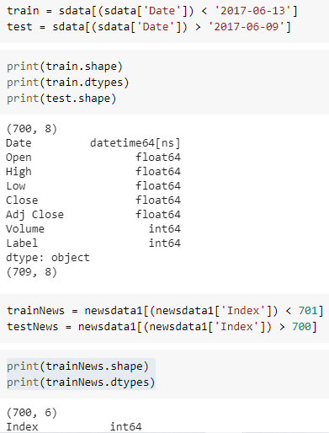
Train and test split
The ratio to divide the train and split is chosen to be 70-30.

Slide 5
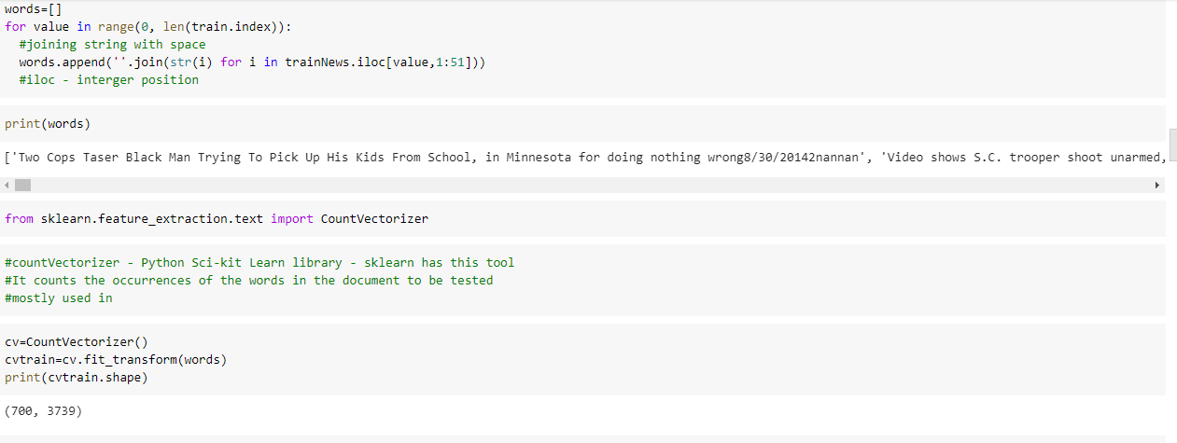
Count Vectorizer

Slide 6
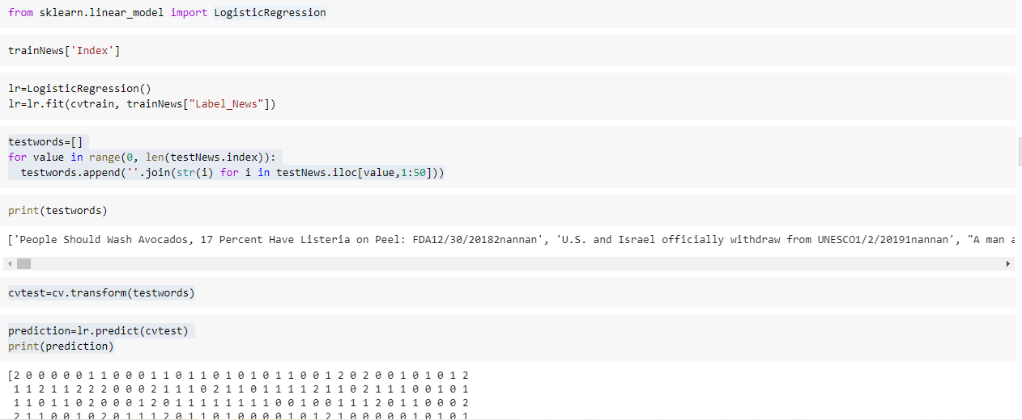
Logistic Regression
Accuracy score = 0.408

Slide 7
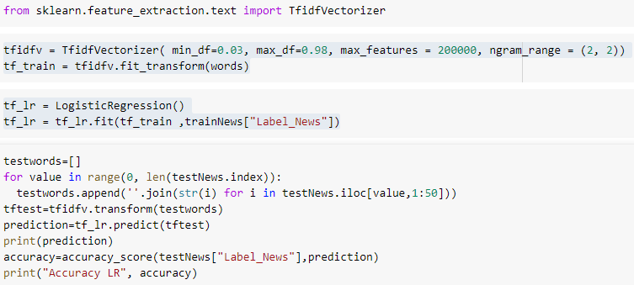
TF-IDF Vectorizer
Accuracy score = 0.408

Slide 8
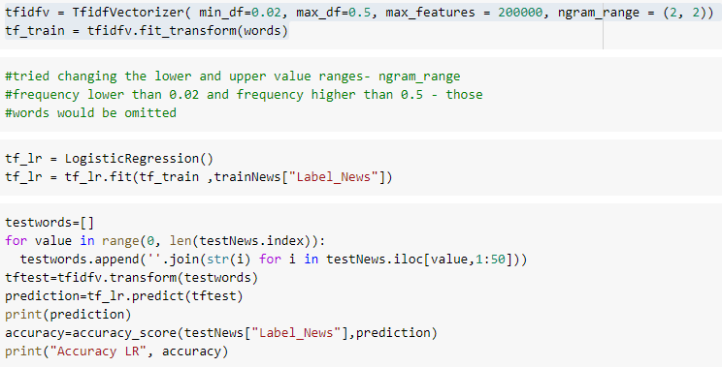
Another try by changing parameters

Slide 9
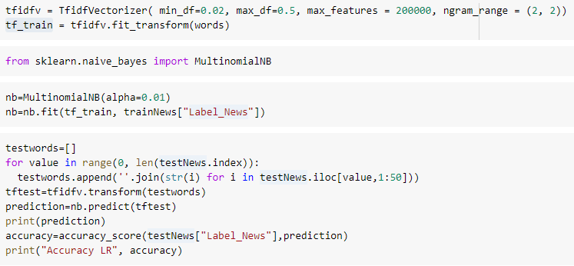
Naive Bayes
Accuracy Score = 0.411

Slide 10
Future Improvements
Since the accuracy score is not satisfying. Will implement LSTM , gradient boosting for a better model.

